Slide 1
MODERNISATION FUND
Nikos Mantzaris, The Green Tank
NOVEMBER 16, 2021

Slide 2
OBJECTIVE AND SCOPE
Support 10 lower-income EU Member States in their transition to climate neutrality by helping them to modernize their energy systems and improve energy efficiency.
Aims at financing:
Generation and use of electricity from renewable sources
Improvement of energy efficiency
Energy storage and Modernisation of energy networks
Supporting a just transition in carbon-dependent regions
Cannot finance:
Investments which involve solid fossil fuels
Exception: coal-based district heating in Bulgaria and Romania
Modernisation Fund
2

Slide 3
ELIGIBILITY AND ALLOCATION
MS with a GDP per capita at market prices below 60 % of the Union average in 2013
Size: 2% of allowances of the 4th EU ETS phase
MS can transfer allowances from Art10c and/or solidarity fund (Art10(2)b)
@ 60 €/t ~ € 38,6 billion, 87% in 4 MS (RO, CZ, PL, SK)
Greece also receives 25 million allowances from the unallocated in the 3rd phase
Modernisation Fund
3

Slide 4
PRIORITY INVESTMENTS
At least 70% of the MF to:
Generation and use of electricity from renewable sources
Improvement of energy efficiency including investments in energy efficiency in transport, buildings, agriculture and waste
Energy storage and the modernisation of energy networks including district heating pipelines, grids for electricity transmission & interconnections between MS
Support a just transition in carbon-dependent regions
First tranche: Aug 2021 – 304.4 million
Implementation of photovoltaic installations (€202 m, CZ)
Roll-out of smart meter infrastructure (€44m, Poland)
Development of power grids for future electric car charging stations (€22 m, PL)
Promotion of energy efficiency in existing buildings (€25 m, PL)
Establishment of energy communities (€11.43 m, HU)
Modernisation Fund
4

Slide 5
NON - PRIORITY INVESTMENTS
Up to 30% of the MF
All projects proposed by the MS not falling into the 4 priority areas
MF can cover only up to 70% of such investments
Examples:
District Heating and Cooling Systems
Gas Infrastructure
Electricity and/or Heat Generation
1st batch of projects approved on Oct. 26 2021
Modernisation Fund
5

Slide 6
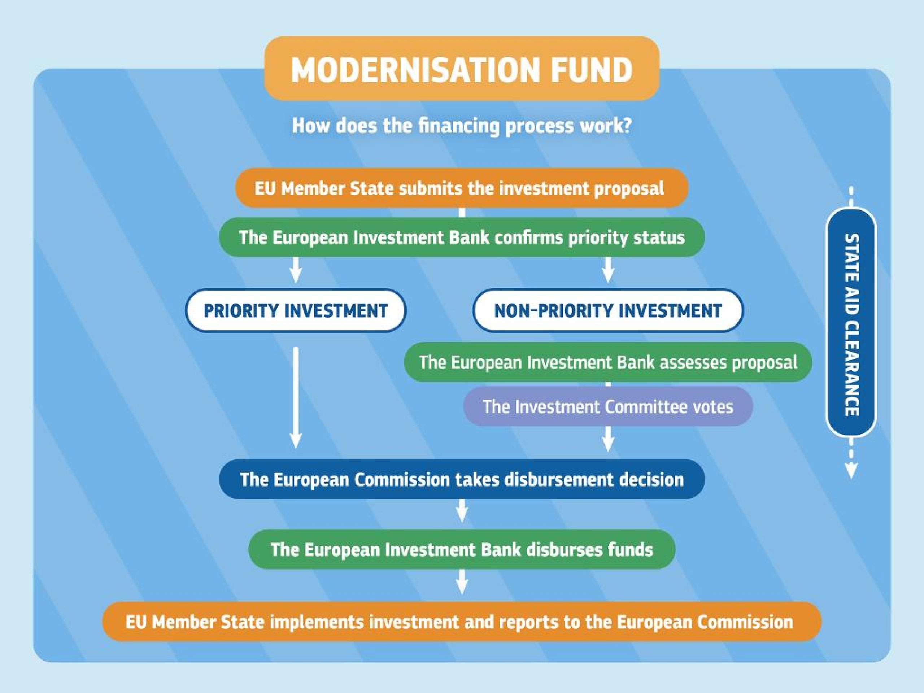
FINANCING PROCESS
Modernisation Fund
6

Slide 7
CHANGES IN THE EUROPEAN COMMISSION’S PROPOSAL
Ban in fossil fuel investments for energy generation
Increase in the share of priority investments from 70% to 80%
2 additional priority areas
Heating and cooling from renewables
Support of low-income households
Target energy efficiency at the demand side
Establishment of a second Modernisation Fund
2,5% of total allowances from year of entry into force
eligibility for MS with a GDP per capita below 65 % of the EU average in 2016-2018
Greece and Portugal become eligible
Modernisation Fund
7

Slide 8
CHALLENGES
Lack of transparency
National level
EIB
Submissions of fossil gas projects (CZ, PL)
ASSESSMENT & RECOMMENDATIONS
Ban of fossil fuel energy investments is very positive
Increase in the size of the fund should also be kept
More transparency
Explicit alignment of MF projects under the Just Transition priority area with Territorial Just Transition Plans
Modernisation Fund
8

Slide 9
THANK YOU
CONTACT US
ADDRESS
123 Anywhere St., Any City
TELEPHONE
123-456-7890
E-MAIL
hello@reallygreatsite.com

