Slide 1
The Innovation Fund
Agnese Ruggiero (Carbon Market Watch)
DATE 11/02/2022
Notes:
Main comments:
more graphs and pictures
clarity on industrial emissions covered by FA
Add in EC proposal, and NGO asks (perhaps one slide at the end of each section on EC proposal for those elements and CAN E reaction)

Slide 2
What is the Innovation Fund?
The ETS Innovation Fund is one of the two funding mechanisms included in the ETS Directive
It is a European Fund dedicated to supporting the demonstration of innovative low-carbon technologies
The EU ETS cap
‹#›
Notes:
There is a cap, below that there the possibility of trading (between operators and/or financial intermediaries)
Cap can be exceeded by emissions in any given year

Slide 3
01.
Here the title of the section
How it is funded?
The revenues for the Innovation Fund come from the auctioning of 450 million EU ETS allowances between 2020 and 2030 + any unspent funds from the NER300 programme
The actual amount of resources depends on the carbon price
🡪 55 EUR/t = 27.5 billion EUR (over 10 years)
The EU ETS cap
‹#›

Slide 4
01.
Here the title of the section
What does it fund?
The IF funds large-scale and small-scale projects focusing on:
Innovative low-carbon technologies and processes in energy-intensive industries, including products substituting carbon-intensive ones
Carbon capture and utilisation (CCU)
Construction and operation of Carbon capture and storage (CCS)
Innovative renewable energy generation
Energy storage
The EU ETS cap
‹#›
Notes:
Cap has never been ‘stringent’

Slide 5
01.
Here the title of the section
How are project selected
How is it changed?
Small-scale projects = eligible costs < 7.5 million EUR are selected through a simplified procedure
Large-scale projects = eligible costs > 7.5 million EUR are selected through a 2-stage application procedure
Selection criteria:
Effectiveness of GHG emission avoidance
Degree of innovation
Project maturity
Scalability
Cost efficiency
The EU ETS cap
‹#›
Notes:
Annual decrease: is internalised by operators: carbon prices will increase decarbonisation efforts knowing the cap decreases and price as expected to increase

Slide 6
01.
Here the title of the section
Financing and Implementation
Funding is given in forms of grants covering up to 60% of the additional capital and operational costs of large-scale projects
The European Commission has the overall management of the Innovation Fund and is ultimately responsible for the selection of the projects that will be funded
Member states are consulted on the list of pre-selected projects before grants are awarded
The EU ETS cap
‹#›
Notes:
Illustrate: still could be emissions under a zero emission

Slide 7
01.
Here the title of the section
First large stage Call
How SHOULD it change?
Size: 1 billion EUR
Applications received: 311
Total amount requested: 21.7 billion EUR
CO2 emissions to be reduced: 1.2 billion tonnes
The EU ETS cap
‹#›

Slide 8
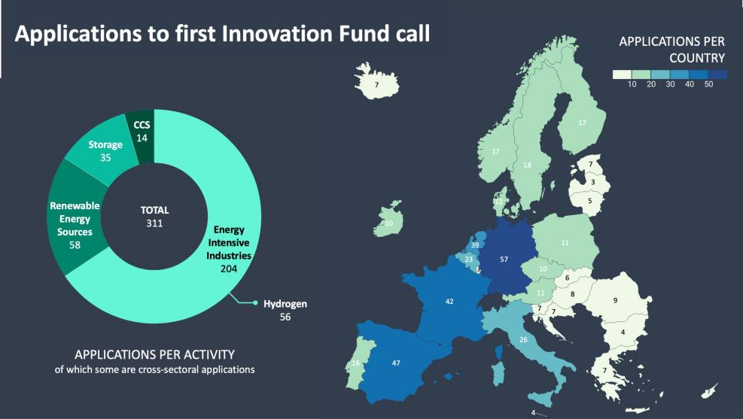
01.
Here the title of the section
The EU ETS cap
‹#›

